Slide 1

HERON
UAS GNSS-R
Update 1.02
HERON GNSS-Reflectometry Graduate Project
Jack Abrams, Frances Bailey, Nathan Cohen, Grace Halbleib, Austin Hunter, Andras Szalay
Smead Aerospace Engineering Sciences Dept. · CCAR · University of Colorado Boulder
September 9, 2026
University of Colorado Boulder · Center for Astrodynamics Research

Slide 2
→ Quad Chart Update
1.02
→ Sub Team Plans
Update Outline
→ UAV Hardware & Flight Planning
→ SDR & Data Processing
→ Conclusions & Questions
HERON | UAS GNSS-R
Smead AES · CCAR · University of Colorado Boulder

Slide 3
Week Update: Sept. 9
UAV Hardware & Flight Planning
SDR & Data Processing
Accomplished This Week
Planned for the Next Week
Heard back from CU Flight Ops
Found part 107 waiver guidelines
Verified UAV GCS/flight-controller connection, sensors, initial battery checks
Developed a finalized plan for SDRs
Performed raw IF capture with B200
gps-tracking-example code working
Reply to CU Flight Ops
Order Remote ID
Capacity-test batteries
Finalize UAV hardware/electrical system block diagram
Place SDR orders
Determine Clock needs
Collect open sky data
Submit URSI Abstract
Current Challenges
Proposed Solutions
TRADE STUDIES & EXTERNAL EXPERTISE
What are the clock needs of our system?
Can the Intel Nuc without overflow on 6 channels simultaneously?
HERON | UAS GNSS-R
Smead AES · CCAR · University of Colorado Boulder

Slide 4
UAV Hardware & Flight Planning
Software Defined Radio (SDR) & Data Processing
UAV Hardware Cataloging
SDR hardware plan for flight payload
FAA/CU Flight Ops Communication
Currently have a contact
Collecting information to send them
Waiting to begin any waivers with the FAA
gps-tracking-example replication of Jiawei figures on Haleakala data
GCS/Flight Planning
Raw IF data Collect
HERON | UAS GNSS-R
Smead AES · CCAR · University of Colorado Boulder

Slide 5
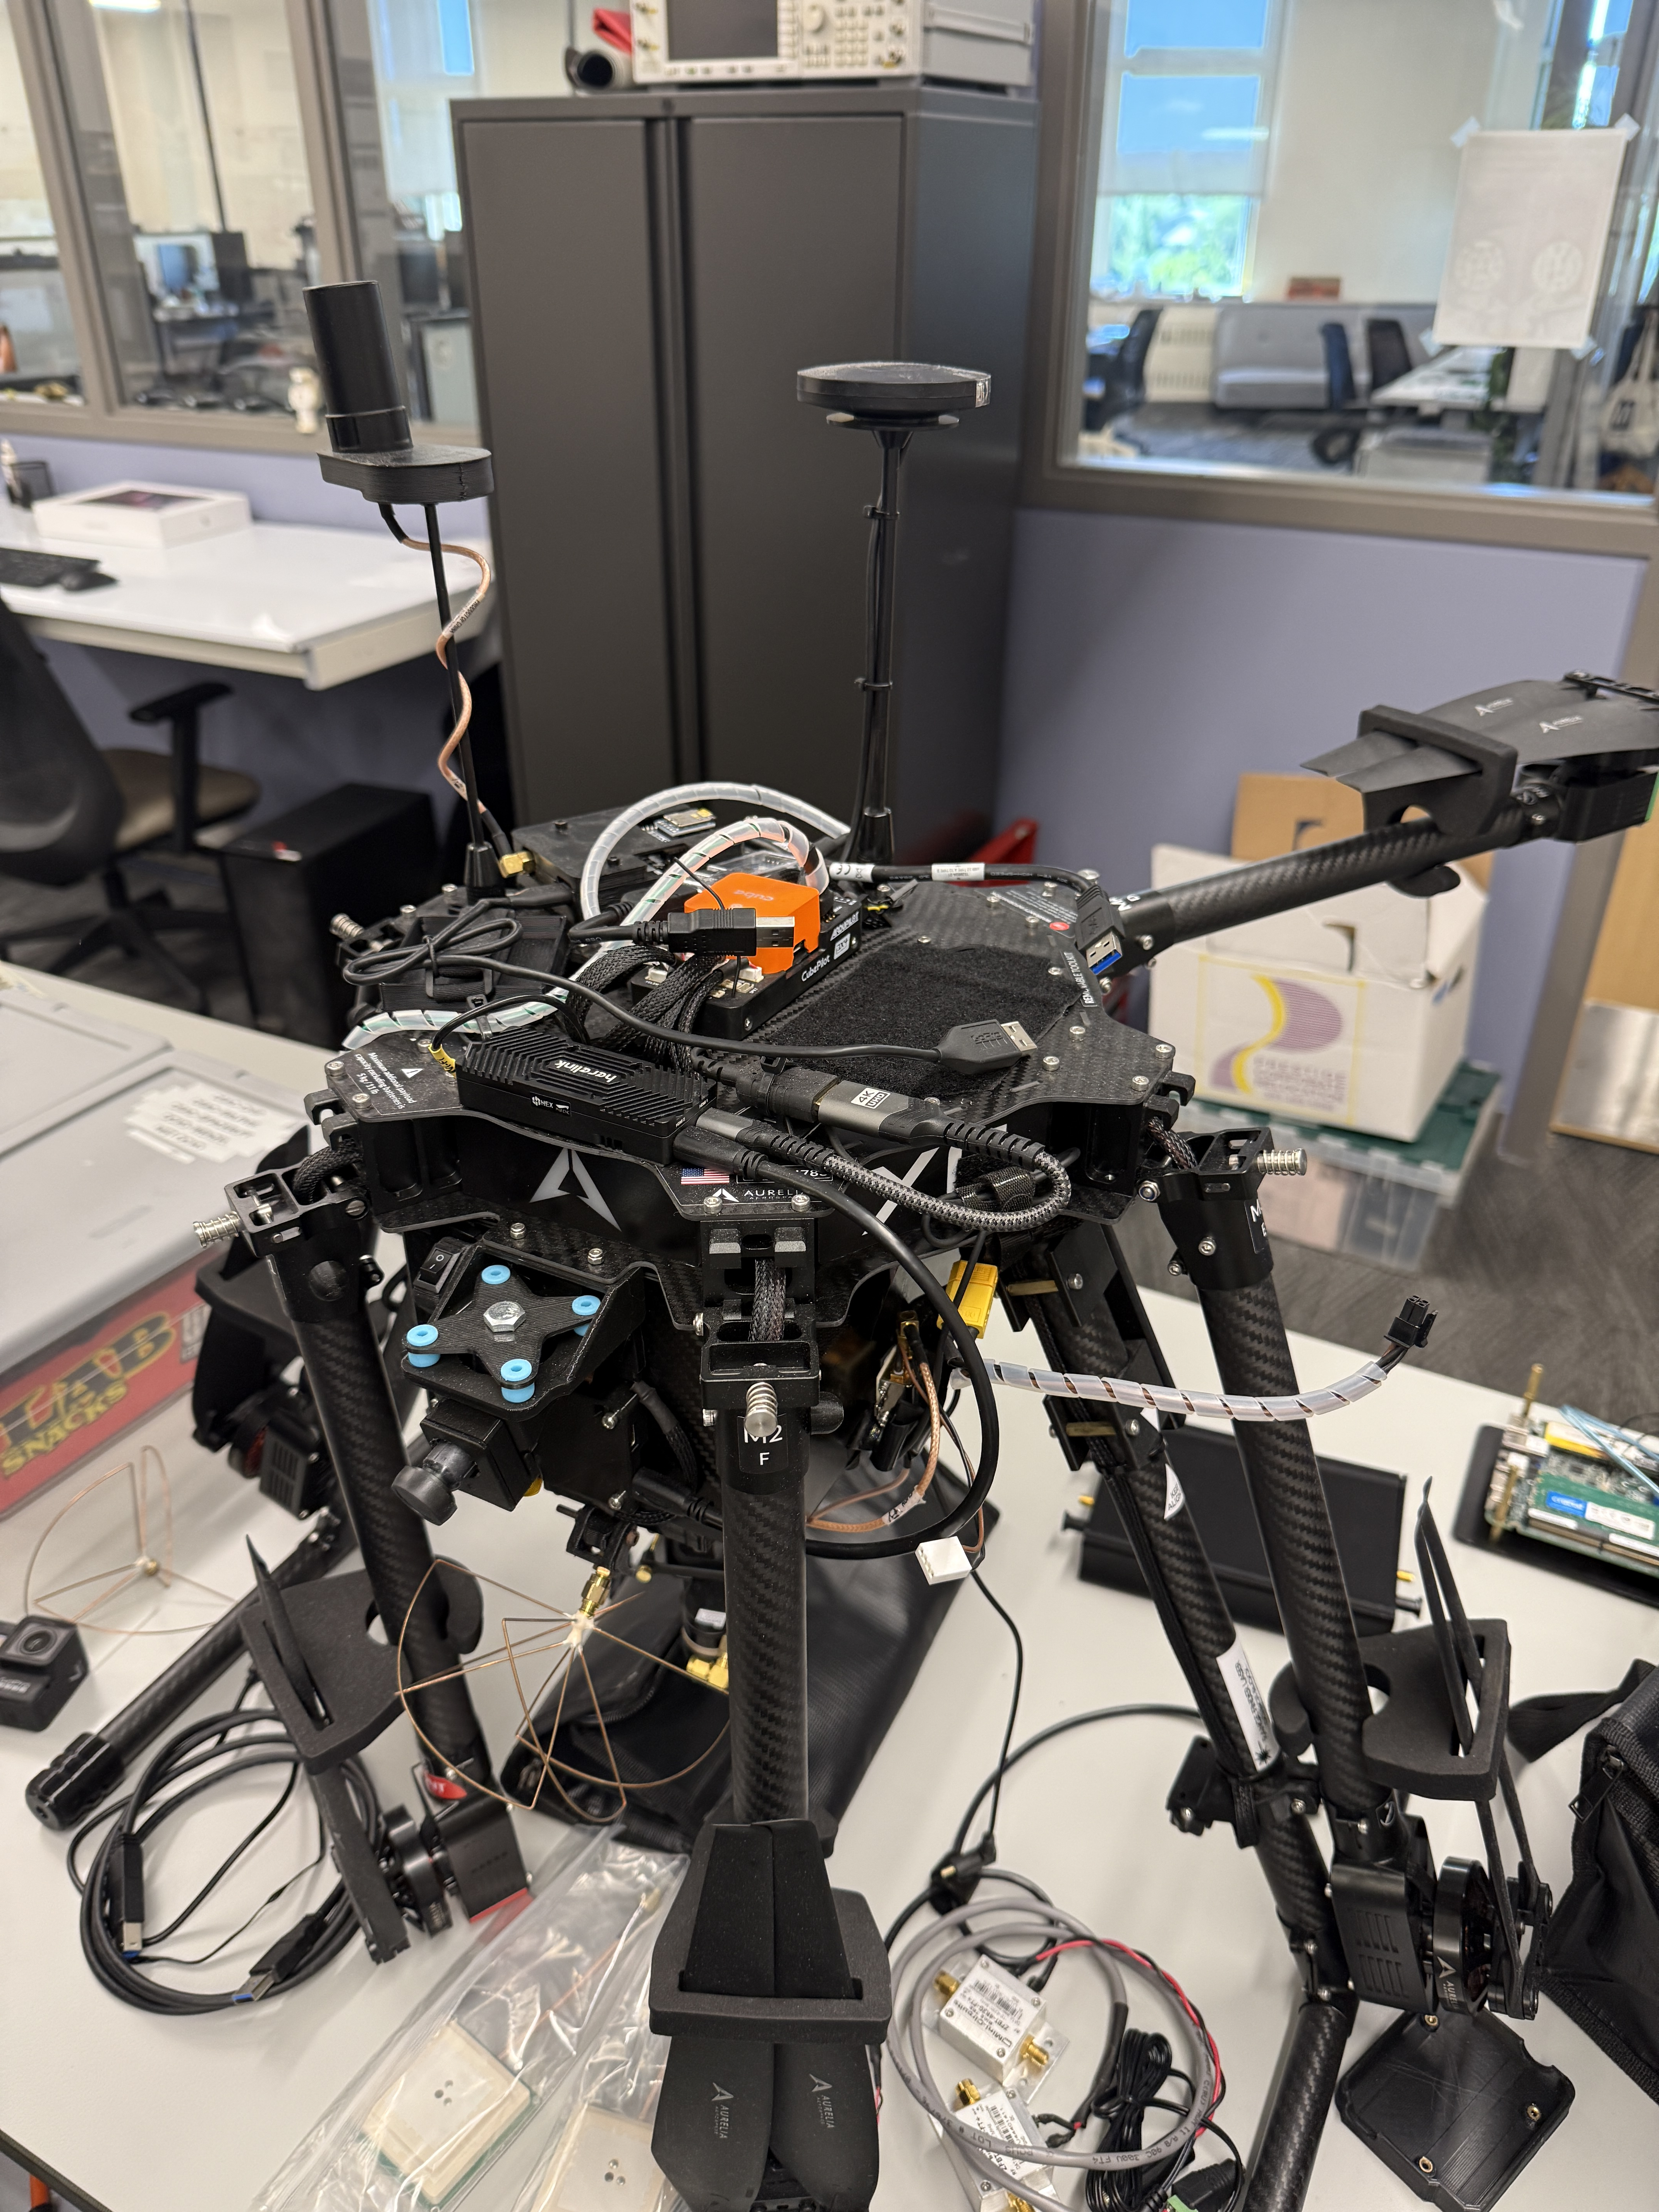
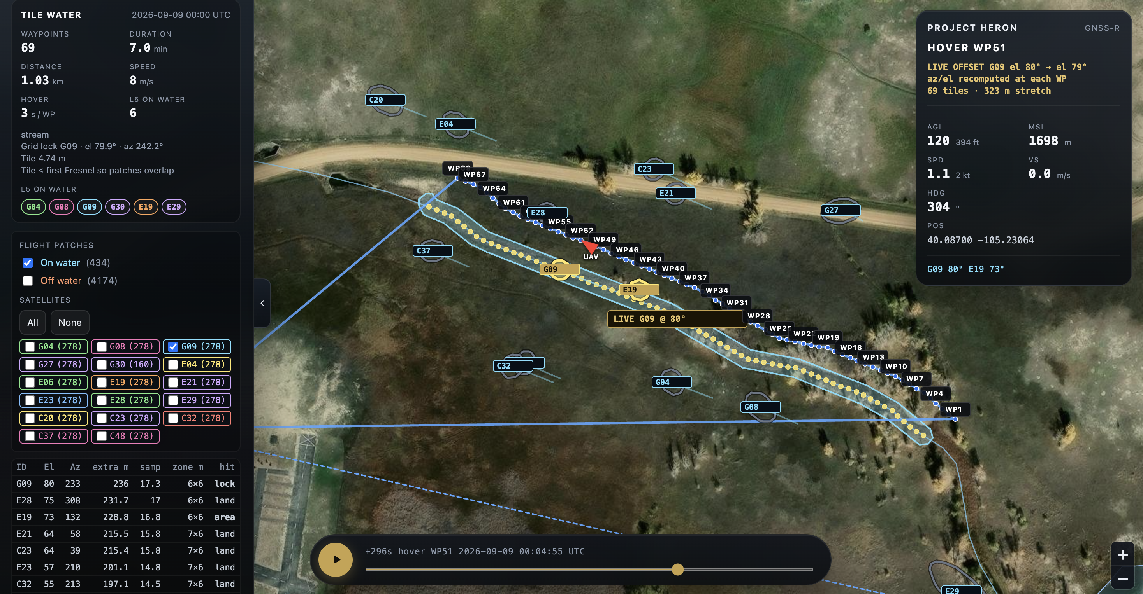
UAV Hardware + Flight Planning
UAV
  Verified GCS connection and flight controller status; confirmed core sensors/telemetry recognized
  Identified need for Remote ID module and began sourcing options
  Checked 4x 6S Li-ion batteries; restored low cells to storage voltage; need to do capacity testing next
  Began mapping UAV components and electrical connections; system block diagram in progress
Flight Planning / Operations
  Complete updated airworthiness registration through flight ops
    All modifications + current configuration
    FAA registration
    Weight & balance
  Submit mission FRAT through Alaris Pro 48 hrs in advance of testing & 1 member must undergo field orientation prior
  Justify waiver to Flight Ops before proceeding with FAA
  Developed GCS MVP for specular-point waypoint generation (demo next week)
Aurelia X6 UAV Platform
Specular-Point Flight Planning Software MVP
HERON | UAS GNSS-R
Smead AES · CCAR · University of Colorado Boulder

Slide 6
SDR Hardware Plan
Duplicate ARGO capability
Unsurprisingly, this appears to be an optimal option for GNSS-R technology research
Testbed matches Navy Payload
Enables direct (RHCP) + reflected signals (L&R HCP)
Keeps SWaP + Cost lower than other USRP options
Legend
SURGE Hardware
Needed Hardware
RHCP Signal
LHCP Signal
Clock 10 MHz
USB
Freq 1
Freq 2
Zenith Antenna
GNSS Rx
B206mini
B206mini
Item | Qty. | Total Wt. | Cost/ unit | Total Cost
USRP B210 | 2 | 700g | $2387 | $4774
USRP B206mini | 2 | 100g | $1599 | $3198
GPSDO? | 1 | 50g | $50-$300 | $200
Ext. GPSDO
Intel Nuc
B210
B210
$8172
GNSS-R Antenna(s)
HERON | UAS GNSS-R
Smead AES · CCAR · University of Colorado Boulder

Slide 7
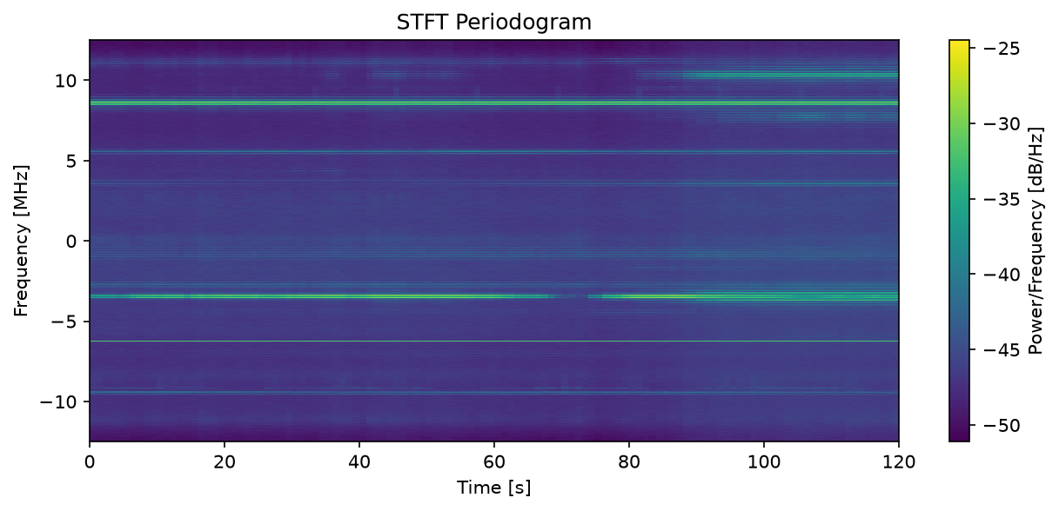
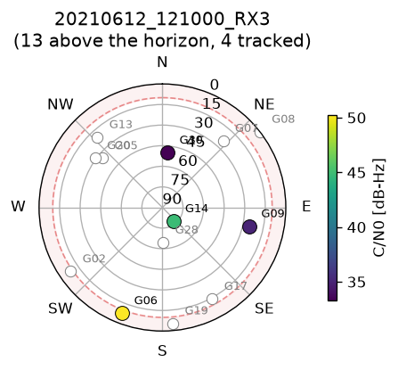
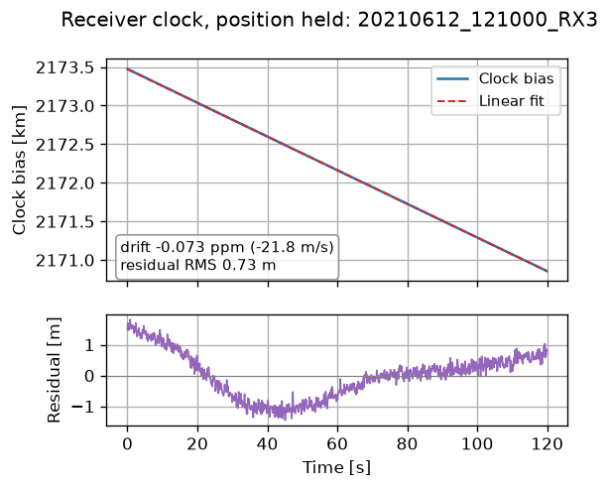
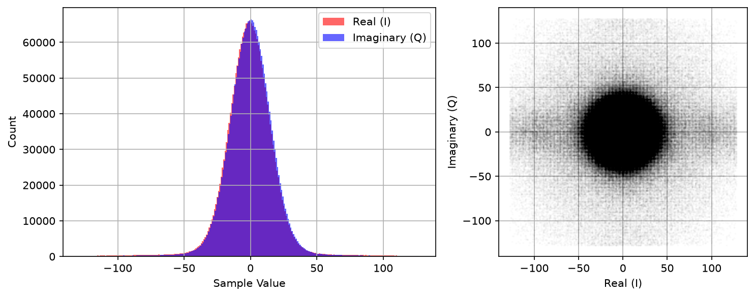
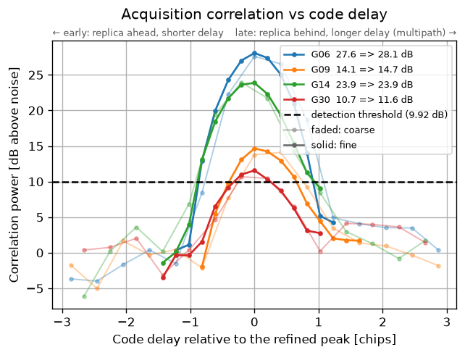
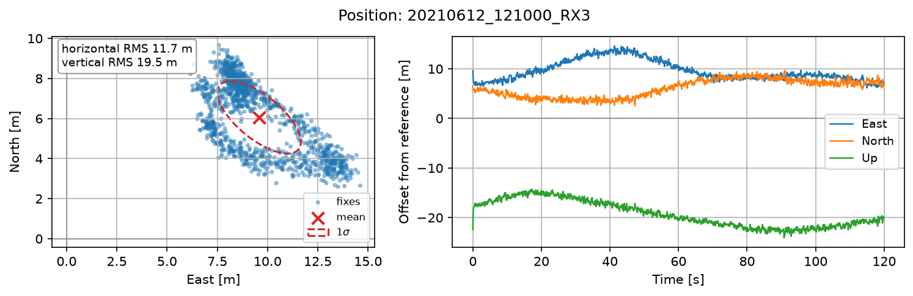
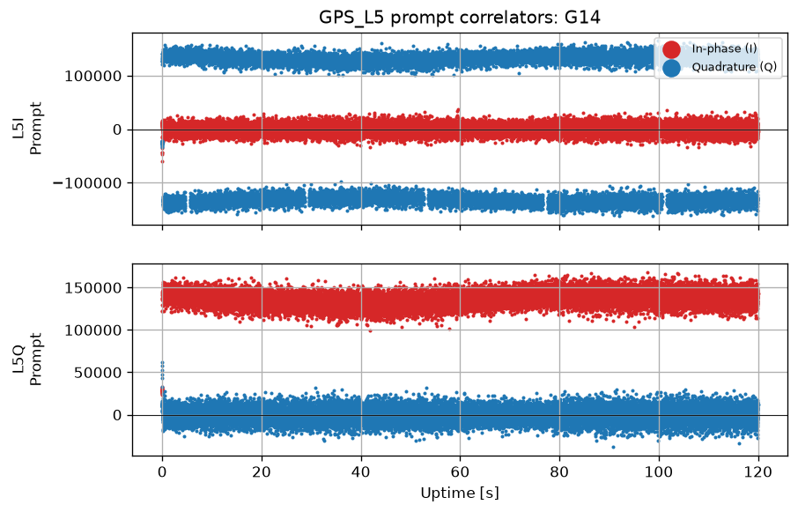
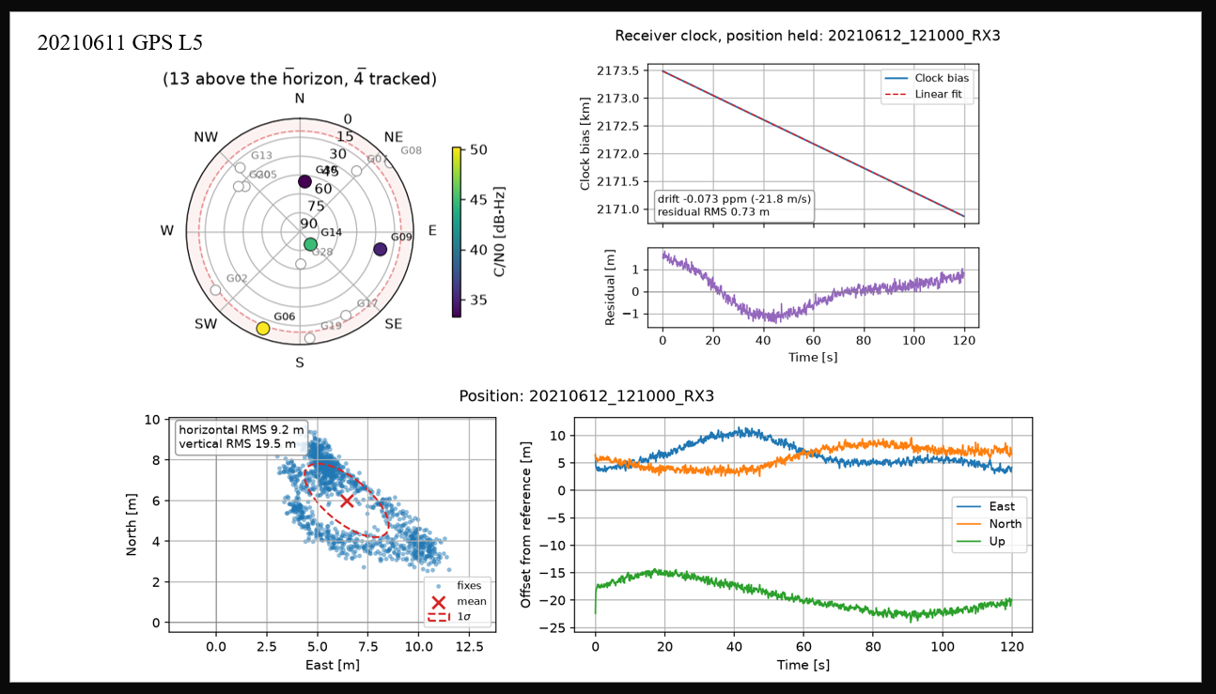
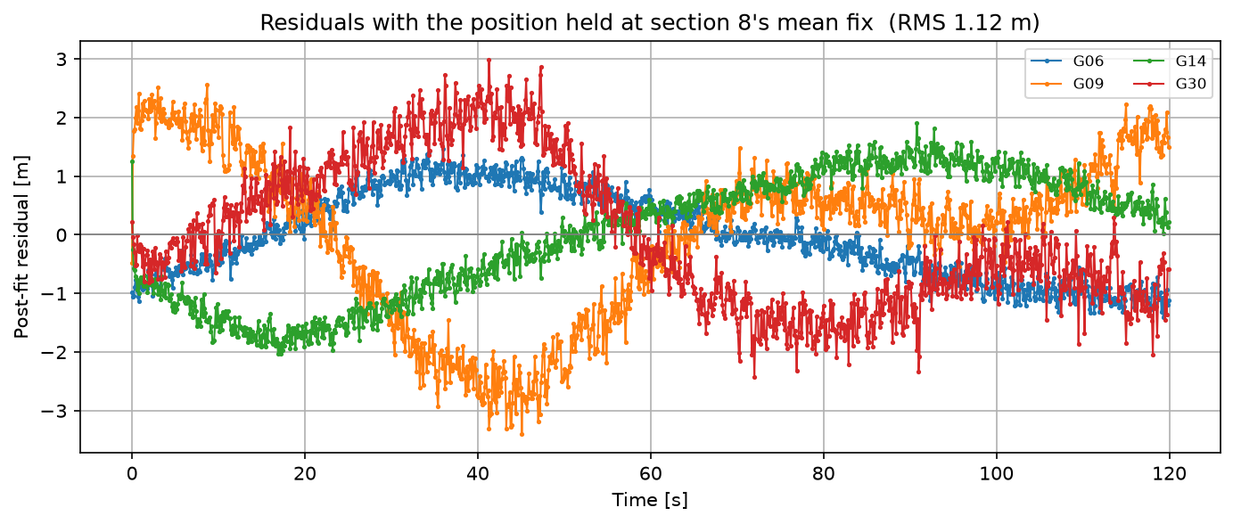
gps-tracking-example Code Test
00
IF Signal Diagnostics ✅
Austin Result
01
Acquisition + Tracking✅
02
Jiawei Result
Navigation Solution ✅
HERON | UAS GNSS-R
Smead AES · CCAR · University of Colorado Boulder

Slide 8
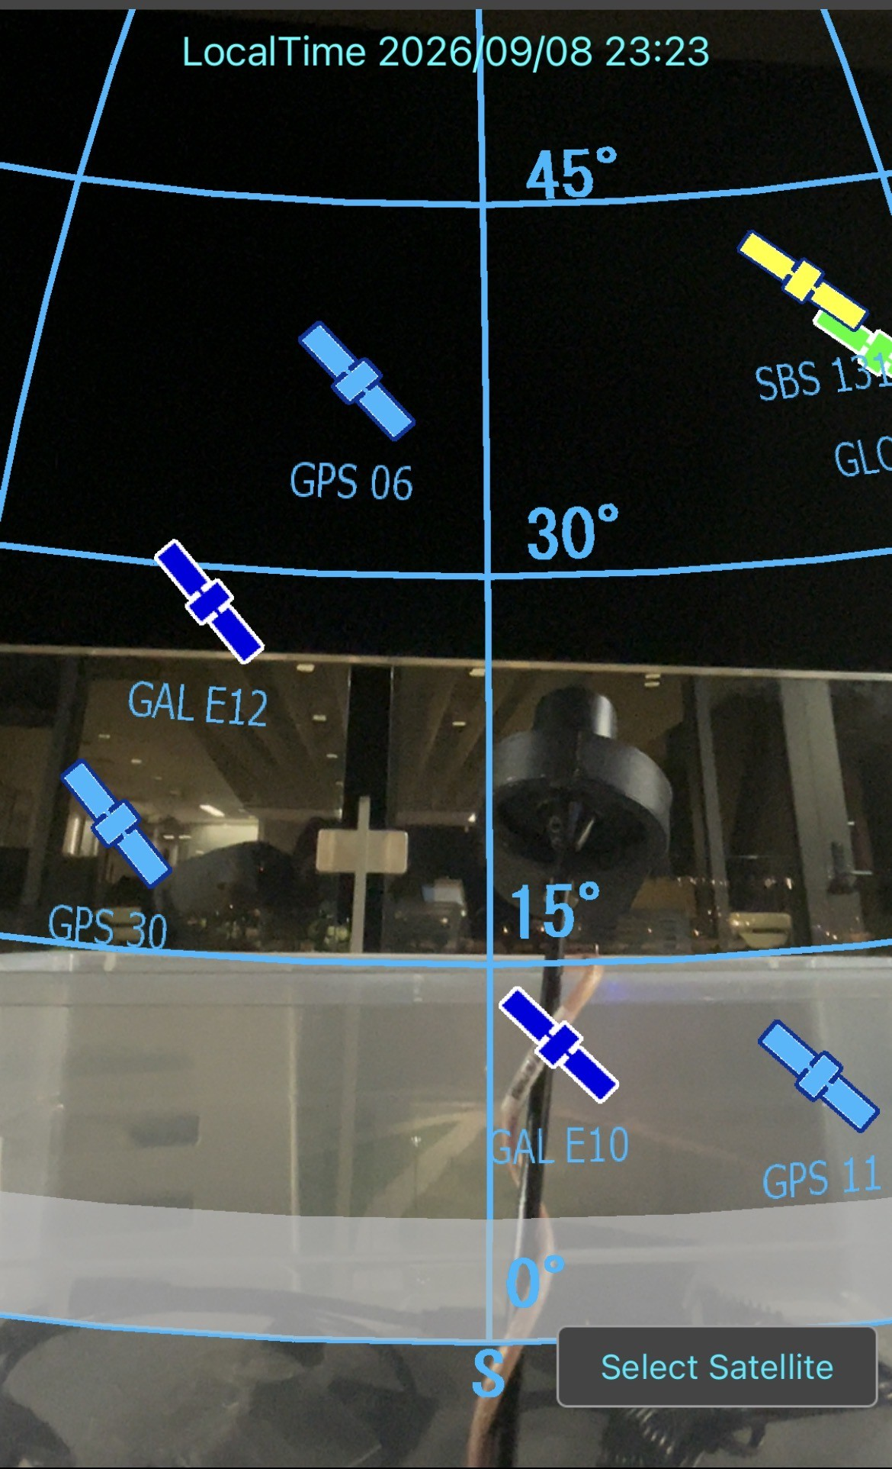
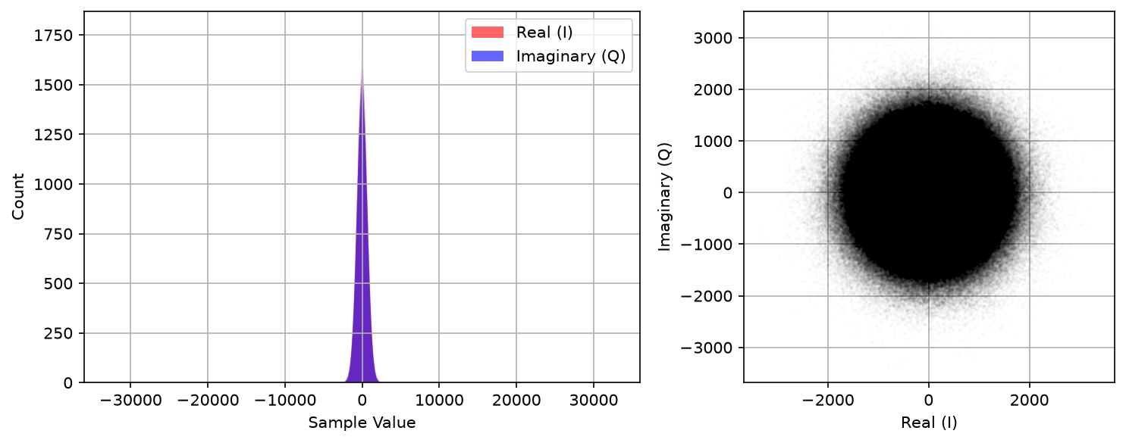
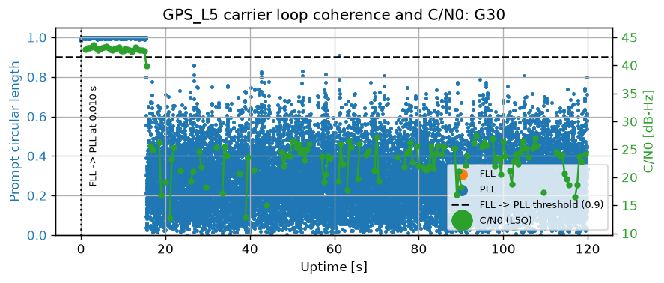
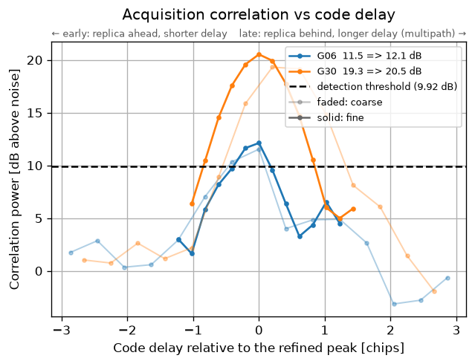
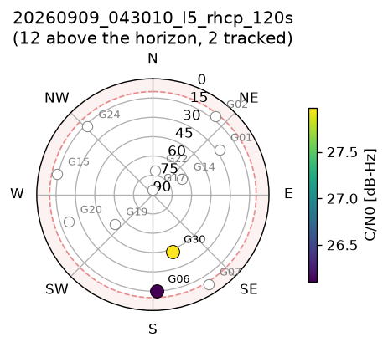
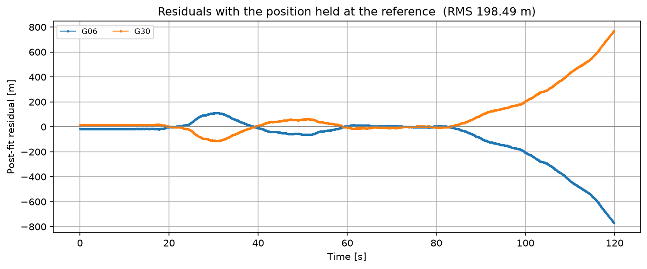
Raw IF Data Collect:
Performed Data Collect on 09/04 & 09/08
00
01
02
HERON | UAS GNSS-R
Smead AES · CCAR · University of Colorado Boulder

Slide 9
Plan for the next week
Overall Objectives
UAV Hardware & Flight Planning
Finish URSI Abstract Submission (internal deadline Thursday for draft)
Add finalized semester review Presentations to calendar
Determine if we have CAD drawing file from SURGE & update system block diagram
UAV Hardware & Flight Planning
Software Defined Radio (SDR) & Data Processing
Finalize and order Remote ID hardware
Complete battery capacity/health testing
Complete updated UAV system block diagram / electrical connection diagram
Submit updated documentation to CU Flight Ops + initial proposal for FAA waiver
Begin preparations for the initial non-science UAV flight / system checkout
Place Order(s) for SDR and clock
Perform full sky data collect
Improve SDR logging code to make more user friendly for data processing
Begin antenna comparison/characterization
&
HERON | UAS GNSS-R
Smead AES · CCAR · University of Colorado Boulder

Slide 10
Questions?
Questions & Discussion
University of Colorado Boulder · Center for Astrodynamics Research · HERON Project

Slide 11
Project Goals
UAV Hardware & Flight Planning
Software Defined Radio (SDR) & Data Processing
Update and validate the existing UAS, payload integration, ground control system, and communications links
Complete FAA and CU Flight Ops approvals, safety documentation, and operational checklists
Develop GNSS-R survey missions and software to translate satellite geometry and water body targets into executable flight plans
Collect GNSS-R, trajectory, telemetry, and imagery data during field tests
Characterize the science antenna(s) and validate the upgraded SDR payload data-flow architecture.
Execute and verify raw Intermediate Frequency (IF) baseband data captures during field operations.
Continue to develop acquisition + tracking code to parse raw data and extract direct and reflected signals.
Compute specular reflection points using UAV position solutions, GNSS satellite orbits, and surface topography.
&
Overall Project Goals
Develop and validate a high-resolution UAV-based GNSS reflectometry system capable of measuring inland water body dimensions and surface gradients.
Process the collected data to retrieve accurate surface water boundaries and height variations, bridging the gap between localized in situ sensors and global satellite altimetry for environmental monitoring.
Provide documentation for a general audience to operate the system and retrieve necessary data.
HERON | UAS GNSS-R
Smead AES · CCAR · University of Colorado Boulder

Slide 12
General Project Timeline
September
CU Flight Ops Communication
October
FAA Waiver
November
System Integration Flight
End of Semester 1
Flight Test w/ Reflection Data
April
Raw IF Capture with Current Antenna
Order Antenna’s + Any Additional Hardware
Non-Science Flight
Full Technology Demo Flight
Objective 2: IWB Height
Objective 3: River Slope
Sky and Reflected IF data capture
(ground test)
February
Objective 1: IWB Detection and Mapping
Fly UAV with science payload
Reflection Off Inland Water Body (IWB)
Demonstrate Flight Planning Software
Completed
In Progress
Upcoming
HERON | UAS GNSS-R
Smead AES · CCAR · University of Colorado Boulder

Slide 13

Budgeting and Finance
Budget
Total budget and planned allocation?
Procurement Procedure
How do we go about purchasing materials?
Financial Officer
Who is in charge of purchasing and managing the budget?
HERON | UAS GNSS-R
Smead AES · CCAR · University of Colorado Boulder

Slide 14
Follow up items & questions
UAV Notes
SDR/Signal Processing Notes
Bullet point one with relevant content
Bullet point one with relevant content
&
HERON | UAS GNSS-R
Smead AES · CCAR · University of Colorado Boulder

Slide 15
Week Update: Date
UAV Hardware & Flight Planning
SDR & Data Processing
Accomplished This Week
Planned for the Next Week
List accomplished tasks here
Make the list simple
Details expanded later
List accomplished tasks here
Make the list simple
Details expanded later
Identify a tasks that should be done before next week
List potential deadlines if they are not the next meeting (ex. 09/26)
Identify if there are any needs from Prof. Morton, Post Docs, Engineers etc.
Make tasks clear and concise
Current Challenges
Proposed Solutions
[Add content, figures, bullet points, or charts here]
[Add content, figures, bullet points, or charts here]
HERON | UAS GNSS-R
Smead AES · CCAR · University of Colorado Boulder

Slide 16




Slide 17
[Comparison Slide Title]
[Left Column Header]
[Right Column Header]
Bullet point one with relevant content
Bullet point one with relevant content
Bullet point two with relevant content
Bullet point two with relevant content
Bullet point three with relevant content
Bullet point three with relevant content
VS
Bullet point four with relevant content
Bullet point four with relevant content
Bullet point five with relevant content
Bullet point five with relevant content
HERON | UAS GNSS-R
Smead AES · CCAR · University of Colorado Boulder

Slide 18
[Quad Chart Title]
[Q1 — Top-Left: e.g. Objective / Problem]
[Q2 — Top-Right: e.g. Approach / Method]
[Add content, figures, bullet points, or charts here]
[Add content, figures, bullet points, or charts here]
[Q3 — Bottom-Left: e.g. Results / Data]
[Q4 — Bottom-Right: e.g. Conclusions / Path Forward]
[Add content, figures, bullet points, or charts here]
[Add content, figures, bullet points, or charts here]
HERON | UAS GNSS-R
Smead AES · CCAR · University of Colorado Boulder

Slide 19
[Key Results / Metrics]
[X.XX]
[XX]
[X.X]
dB
%
m
SNR Improvement
Data Recovery Rate
Vertical Accuracy
[Insert chart or figure showing results]
Figure 2. [Caption]
HERON | UAS GNSS-R
Smead AES · CCAR · University of Colorado Boulder

